Slide 1

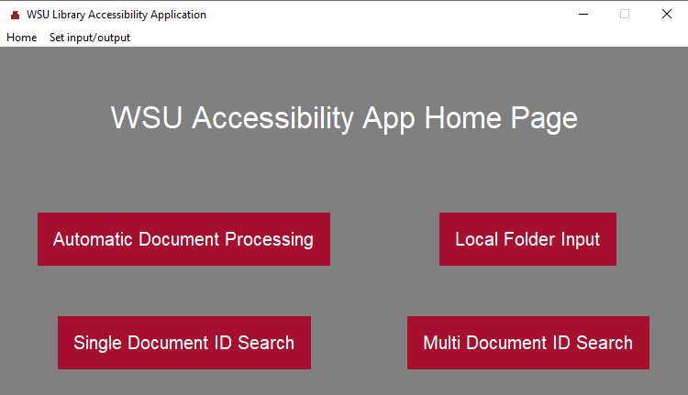
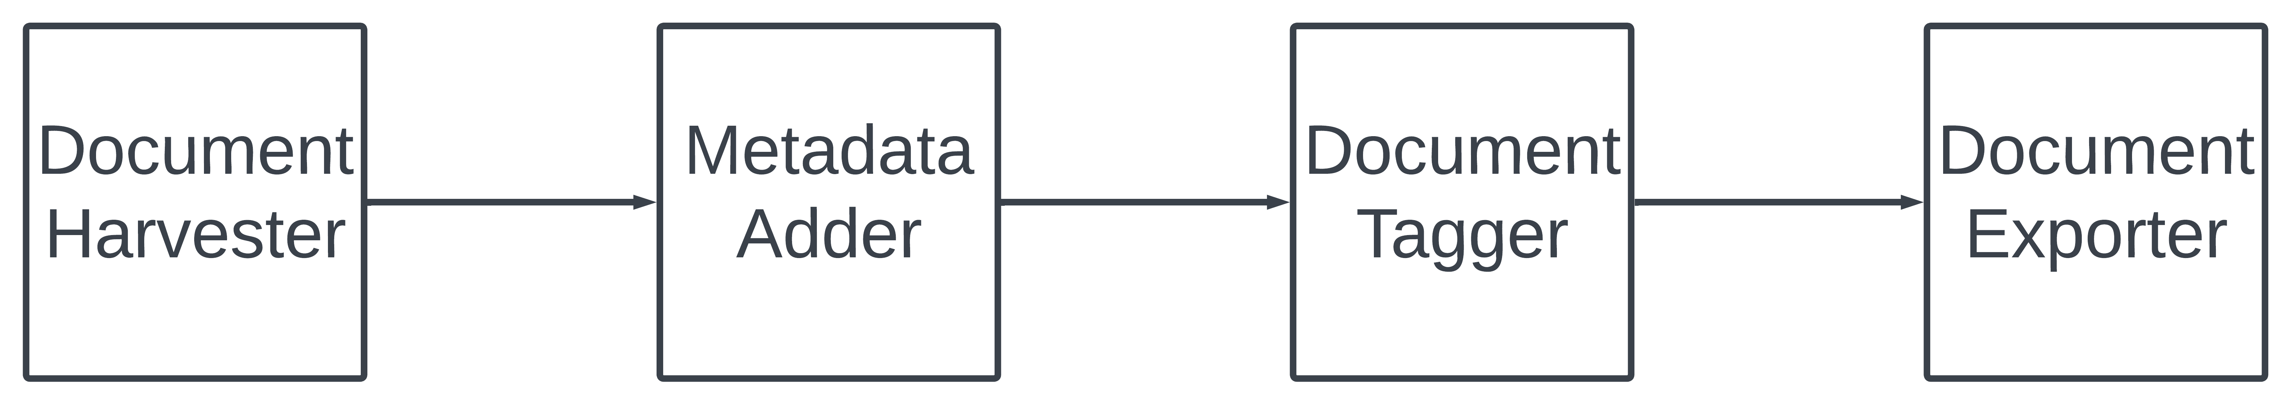
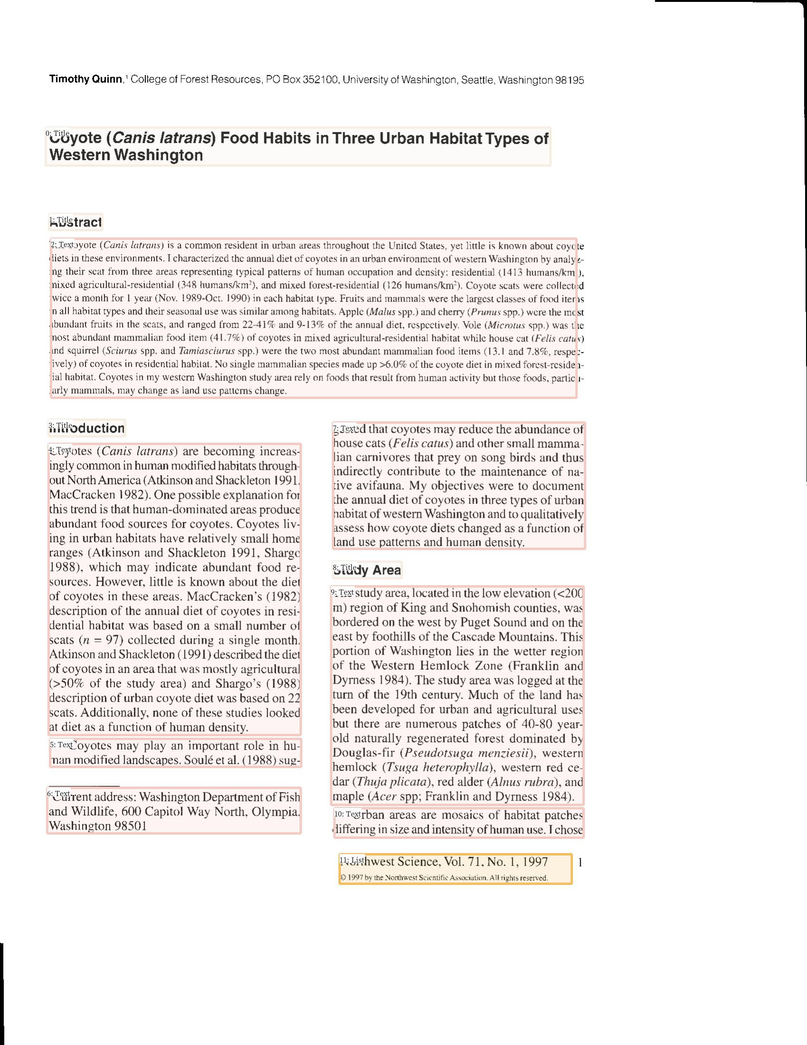
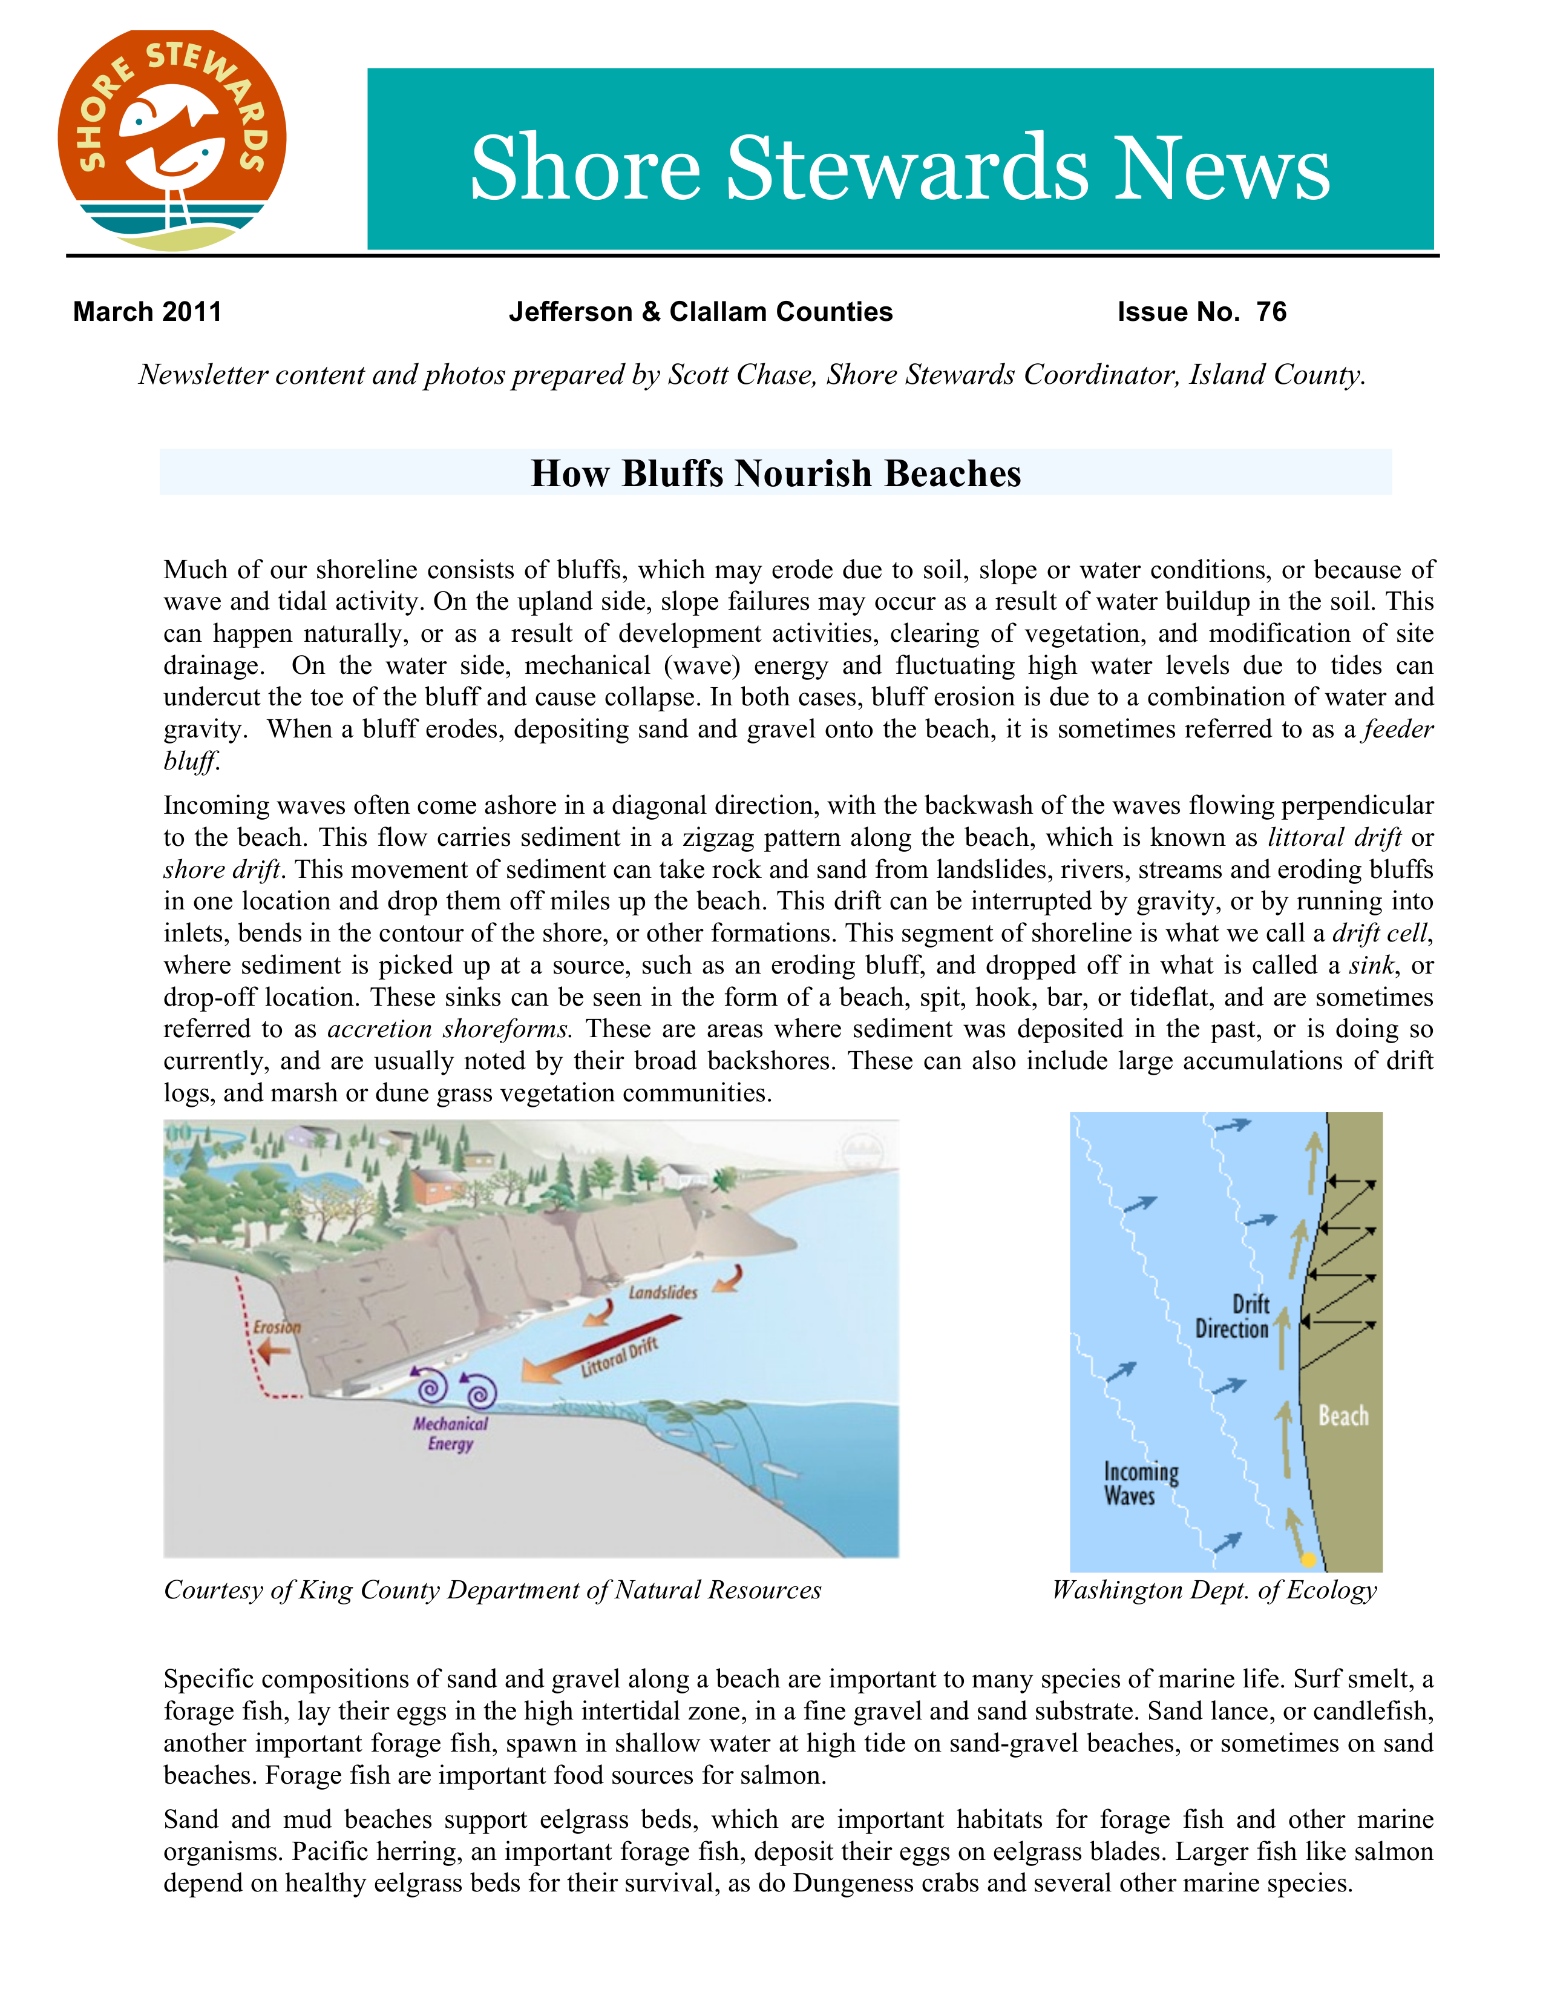
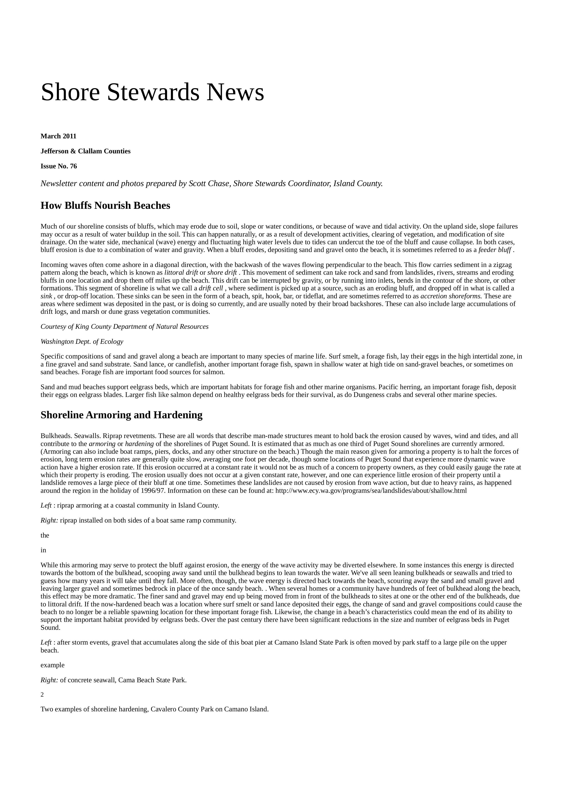
Automated W3C Accessible Document Transformation Sponsor: WSU Libraries Mentor(s): Ananth Jillepalli Trent Bultsma, Reagan Kelley, Marisa Loyd
Development Process
Challenges and Milestones
English reading comprehension
Extracting readable text from PDF file
Machine Learning and layout validation
Tag Tree generation
Smart tree validation
UI multithreading
Standarization of input and output
Pipeline integration
Integration of multiple languages
This whole section should be:goal, challenges, problem solved, methodologies, approach, objectives, limitations, future work
Focus on goal, methododologies, objectives, and future work
The main goal of the document exporter in our project creates an accessible version of a PDF downloaded from the Research Exchange website based on WCAG guidelines. After a document is downloaded from the website, a tag tree is generated for the document and this tag tree is used to create a html, which is then passed to the exporter function where the html is used to create the new PDF.
The biggest challenge faced during the creation of the exporting functionality of the project was integrating multiple different languages. Python was the base language for our project and node js was used to create the accessible PDF from the html. Quite a bit of research and trial and error were used to find a working implementation of the node js function in python. In the end, a subprocess of the node js function was created in python to call the node instruction needed to run the function, followed by the node js function and, finally, the name of the html. A pdf is created and placed in the output folder in the project.
Future work for our project would include adding more accessibility features such as alternative text for images, extracting images using the layout parser and putting them back into the accessible pdf,
Pipeline process
Go through each part of the pipeline in technical detail and how it works
Development or Pipeline Continued (depending on space required)
Exporter :
Glossary
WCAG – Web Content Accessibility Guidelines that define how to make web content and physical documents more accessible to people with disabilities.
Node js – Cross-platform backend JavaScript runtime environment.
Python - High-level, general-purpose programming language that emphasizes code readability.
Acknowledgements :
Our team would like to thank Ananth Jillepalli, our professor for his wisdom and help during the project. We would also like to thank our sponsor, WSU Libraries, for submitting this project, as well as Talea Anderson, our contact from WSU Libraries, for meeting with our team weekly and providing guidance throughout the project.
WSU Libraries Accessibility Team
Notes:
Digital works are brought to the research exchange repository lacking the initial accessibility standards for digital media set out by the international community and have resulted in copious amounts of educational media with sub-optimal accessibility. Our goal is to create an application that can take a pdf and create a modified version that does not change the comprehension or meaning of the work but heightens that document’s accessibility to that of W3C standards. We implemented a pipeline architecture, that contained three key components: the harvester, transformer, and exporter. Our first obstacle began early with harvesting, which was PDF extraction, a highly technical and proprietary process. We overcame this and other obstacles with the use of numerous extraction libraries, AI, decision trees, multithreading, and various languages. Our future goals involve more accessibility transformations, the use of Adobe PDF-friendly outputs, and an API between our application and the research exchange repository.

